Slide 1
Update-1
22 Feb

Slide 2
Previously
Literature survey and understanding of the current state-of-the-art in foot simulations.

Slide 3
Summary
Improved Simulation Speed- From 7hrs to 20mins
Ease of setup/ Simulation methodology established
Bare Foot Midstance simulated
Fixed-Fixed Arches + Barefoot Simulated
Connected Arches + Barefoot Simulated

Slide 4
Improved Simulation Speed
Previous simulations required over 200,000 elements to run.
This was due to-
Many elements required in the soft tissue
Cartilage between each bone was of complex shape and thus was difficult to mesh
Bones were of complex shape
Changes made-
Mesh of soft tissue is first edited in MeshLab (if needed), imported and edited in fusion 360, imported and edited in Abaqus (cubic, tetrahedral elements with hybrid formulation and improved surface stress visualisation). No’ of elements needed- 6,000
The bones are of simple shapes and can be easily meshed as linear tetrahedral elements. No. of elements needed- 10,000
The use of the embedded constraint to include bones into the soft tissue allowed for cartilages to be removed entirely (a validation study was conducted for the same)

Slide 5
Simulation Methodology
Geometry Establishment
Fusion 360 is used to scale the model, set up positions of all bodies relative to each other (soft tissue, bones, footwear, ground ect.)
Any edits needed to the soft tissue mesh are done in this step
The model is then imported into Abaqus

Slide 6
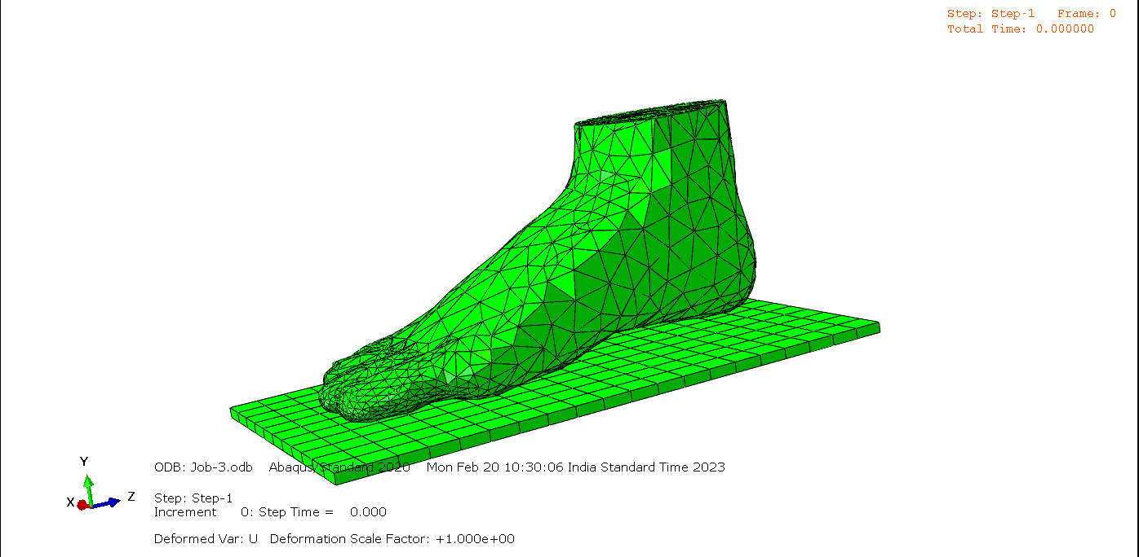
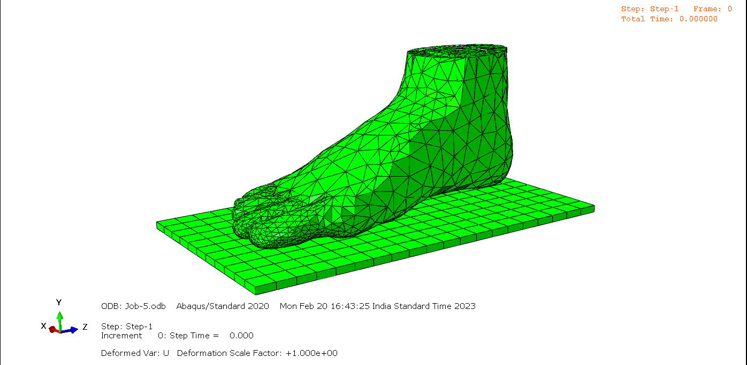
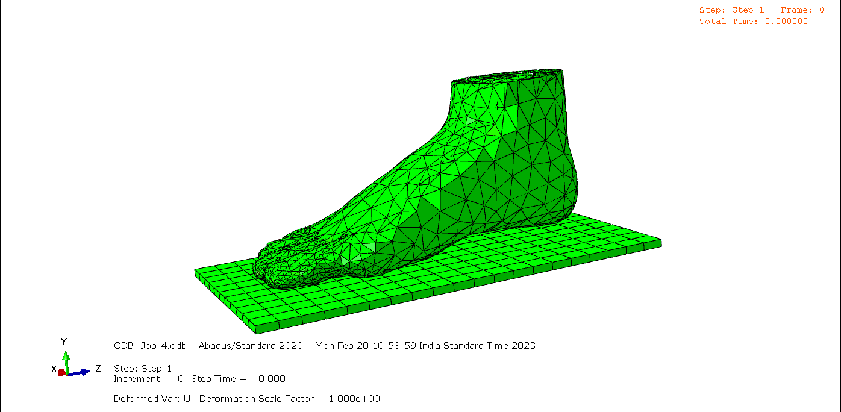
Skin
And Bones
Skin Only
Skin
Bones
And Cartilage

Slide 7
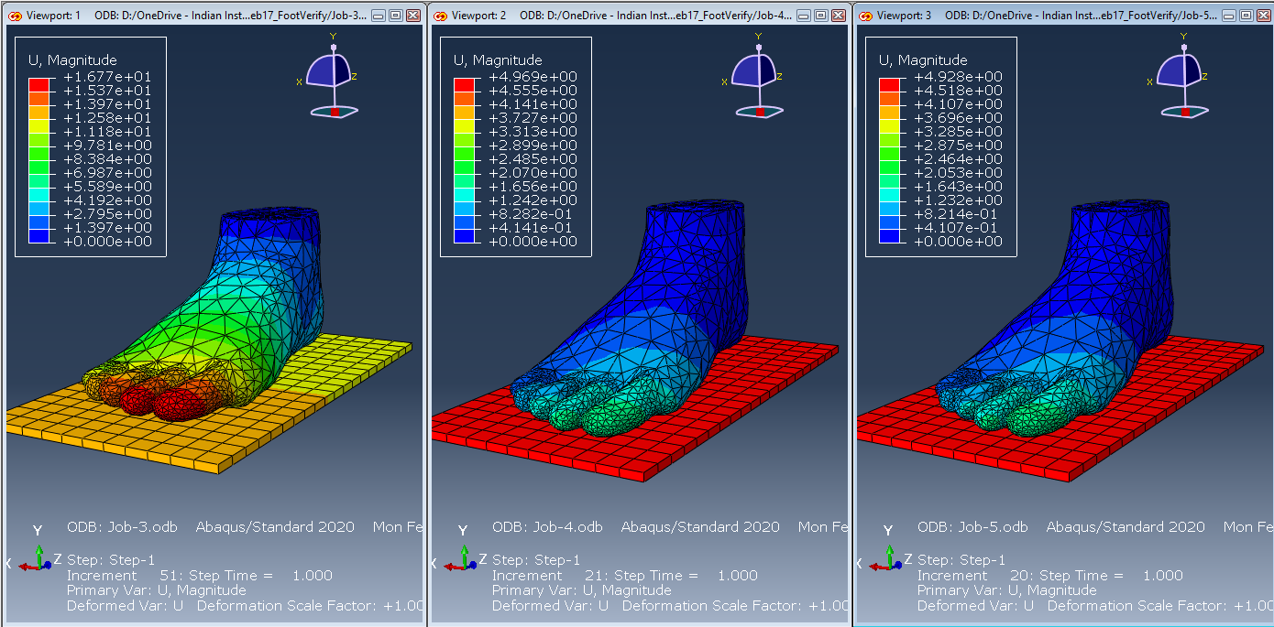
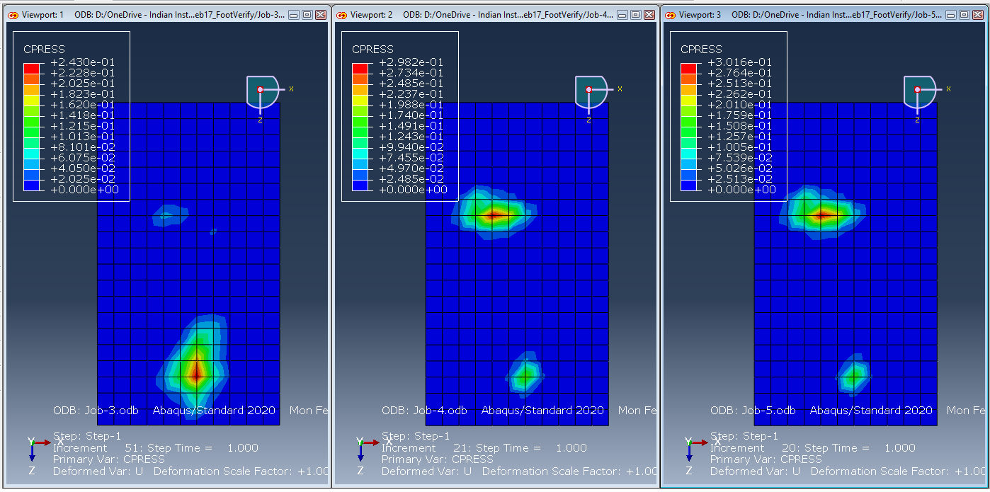
Skin
Bones
And Cartilage
Skin Only
Skin
And Bones

Slide 8
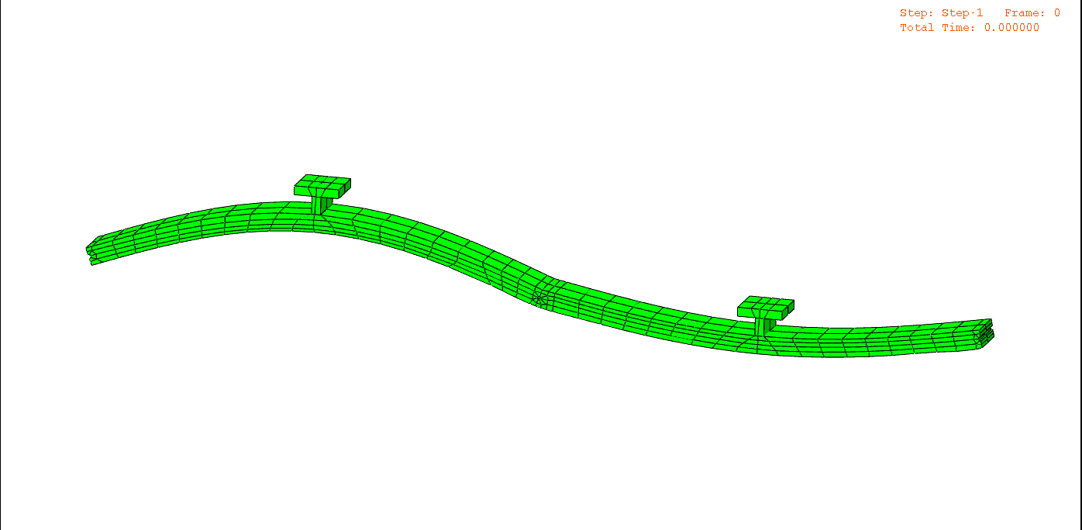
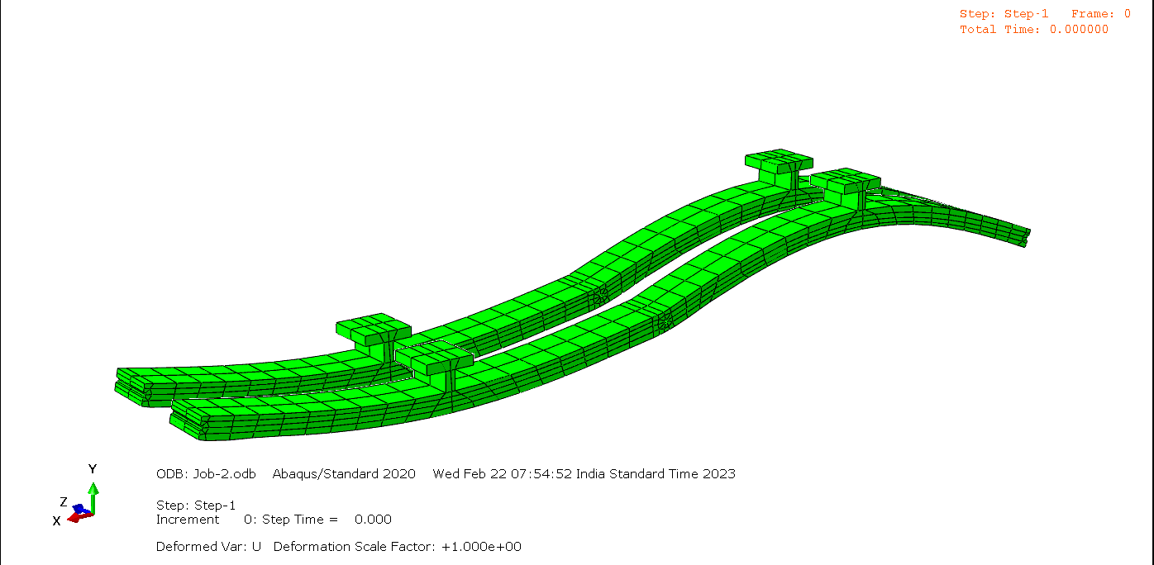

Slide 9
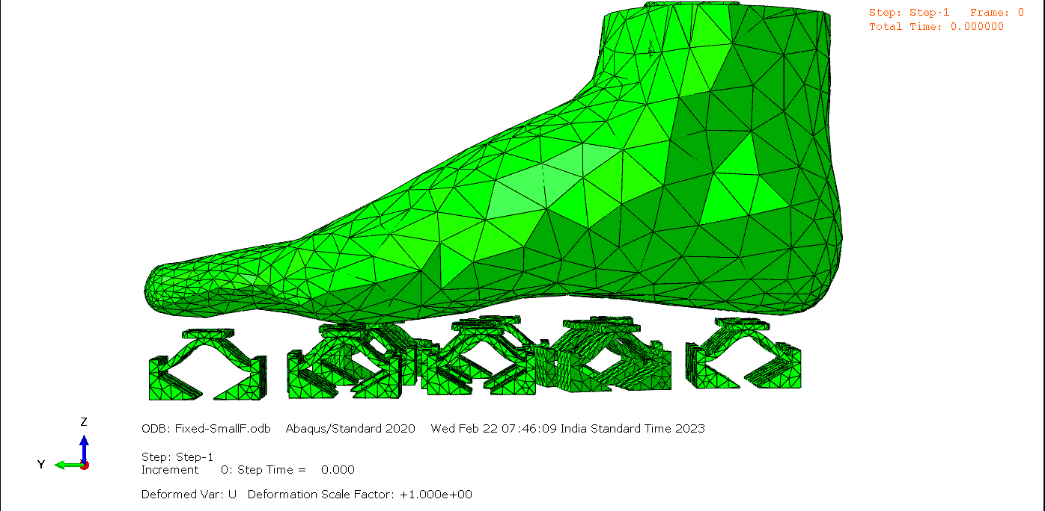
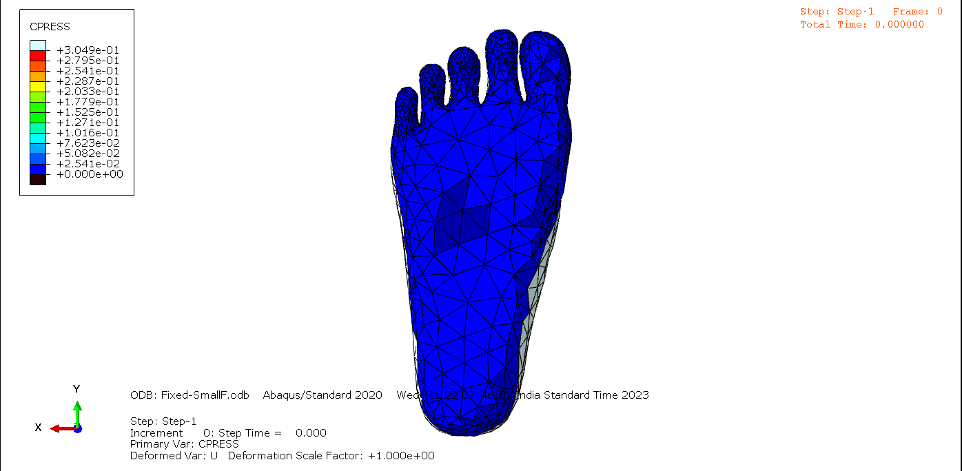

Slide 10
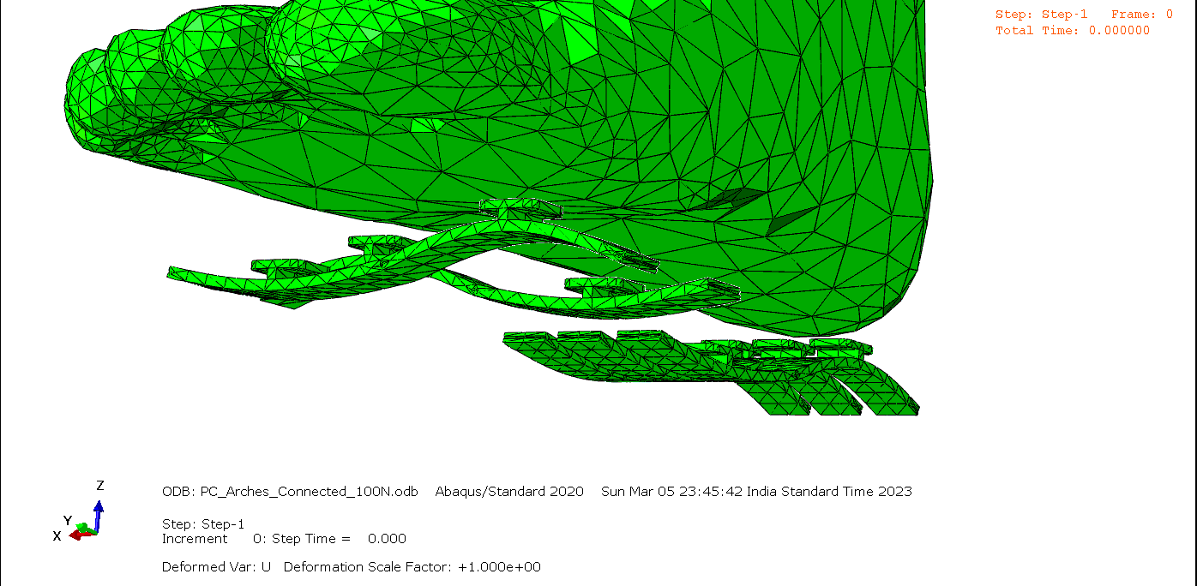
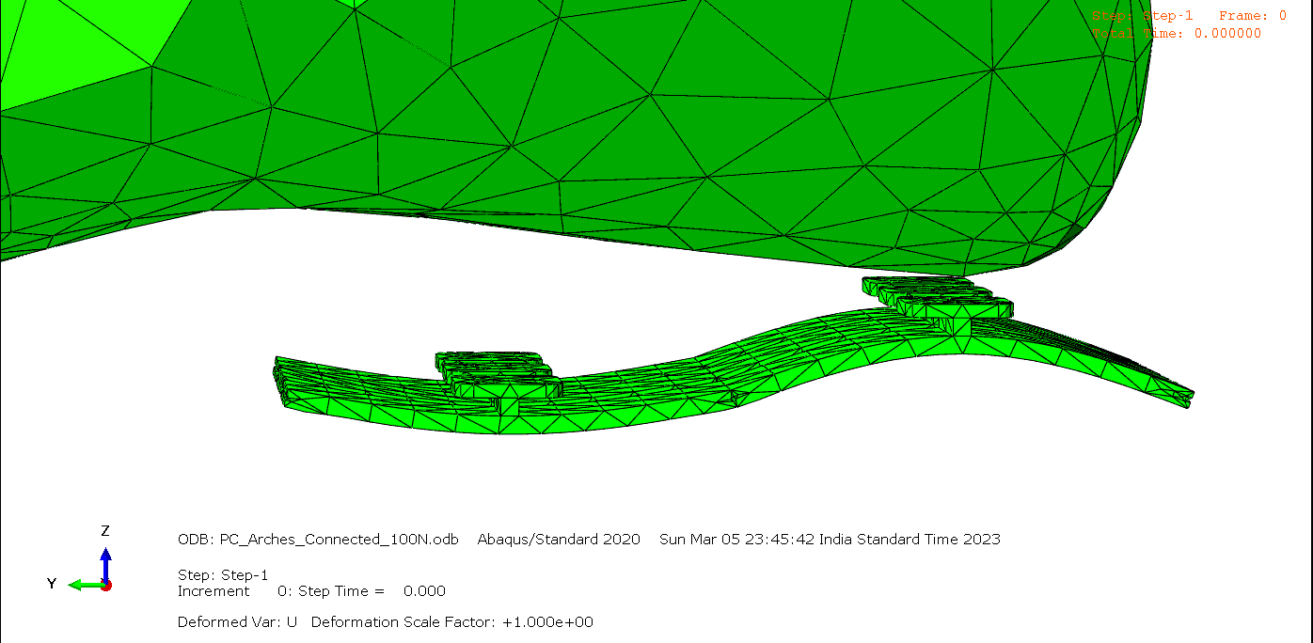
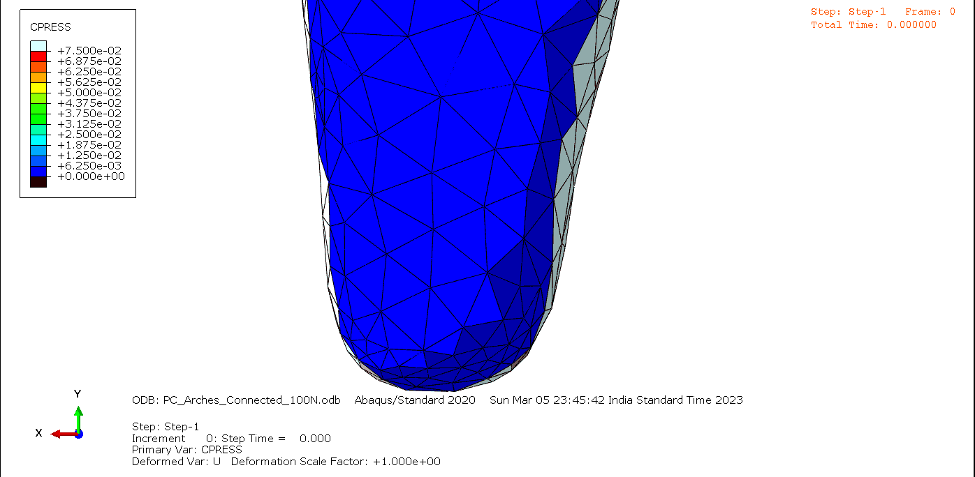

Slide 12
PRIMARY GOALS
Annual revenue growth

Slide 13
QUARTERLY PERFORMANCE

Slide 14
AREAS OF GROWTH
​ | CATEGORY 1 | CATEGORY 2 | CATEGORY 3​ | CATEGORY 4​
Q1 | 4.5​ | 2.3​ | 1.7​ | 5​.0
Q2 | 3.2​ | 5.1​ | 4.4​ | 3​.0
Q3 | 2.1​ | 1.7​ | 2.5​ | 2.8​
Q4 | 4.5​ | 2.2​ | 1.7​ | 7.0

Slide 15
BUSINESS OPPORTUNITIES ARE LIKE BUSES. THERE'S ALWAYS ANOTHER ONE COMING.​
Richard Branson

Slide 16



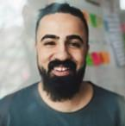
MEET OUR TEAM
TAKUMA HAYASHI
MIRJAM NILSSON
FLORA BERGGREN
RAJESH SANTOSHI
President
Chief Executive Officer
Chief Operations Officer
VP Marketing

Slide 17








MEET OUR TEAM
TAKUMA HAYASHI
MIRJAM NILSSON
RAJESH SANTOSHI
RAJESH SANTOSHI
President
Chief Executive Officer
Chief Operations Officer
VP Marketing
GRAHAM BARNES
ROWAN MURPHY
ELIZABETH MOORE
ROBIN KLINE
VP Product
SEO Strategist
Product Designer
Content Developer

Slide 18
PLAN FOR PRODUCT LAUNCH
Deploy strategic networks with compelling e-business needs
PLANNING
Synergize scalable e-commerce
MARKETING
Disseminate standardized metrics
DESIGN
Coordinate e-business applications
Foster holistically superior methodologies
LAUNCH
STRATEGY

Slide 19
TIMELINE
Q1
Synergize scalable e-commerce
Q2
Coordinate e-business applications
Q3
Deploy strategic networks with compelling e-business needs
Q4
Disseminate standardized metrics

Slide 20
AREAS OF FOCUS
B2B MARKET SCENARIOS
CLOUD-BASED OPPORTUNITIES
Develop winning strategies to keep ahead of the competition
​Capitalize on low hanging fruit to identify a ballpark value
​Visualize customer directed convergence​
Iterative approaches to corporate strategy
​Establish a management framework from the inside​

Slide 21
HOW WE GET THERE
ROI
NICHE MARKETS
SUPPLY CHAINS
Envision multimedia-based expertise and cross-media growth strategies​
​Engage worldwide methodologies with web-enabled technologies​
Pursue scalable customer service through sustainable strategies​
Engage top-line web services with cutting-edge deliverables​​​
Cultivate one-to-one customer service with robust ideas​
Maximize timely deliverables for real-time schemas​

Slide 22
SUMMARY
At Contoso, we believe in giving 110%. By using our next-generation data architecture, we help organizations virtually manage agile workflows. We thrive because of our market knowledge and great team behind our product. As our CEO says, "Efficiencies will come from proactively transforming how we do business."​

Slide 23
THANK YOU
Mirjam Nilsson
mirjam@contoso.com
www.contoso.com

